Slide 1
Lecture 03 Divide and Conquer (Counting Inversion Problem)
CSE373: Design and Analysis of Algorithms

Slide 2


Slide 3
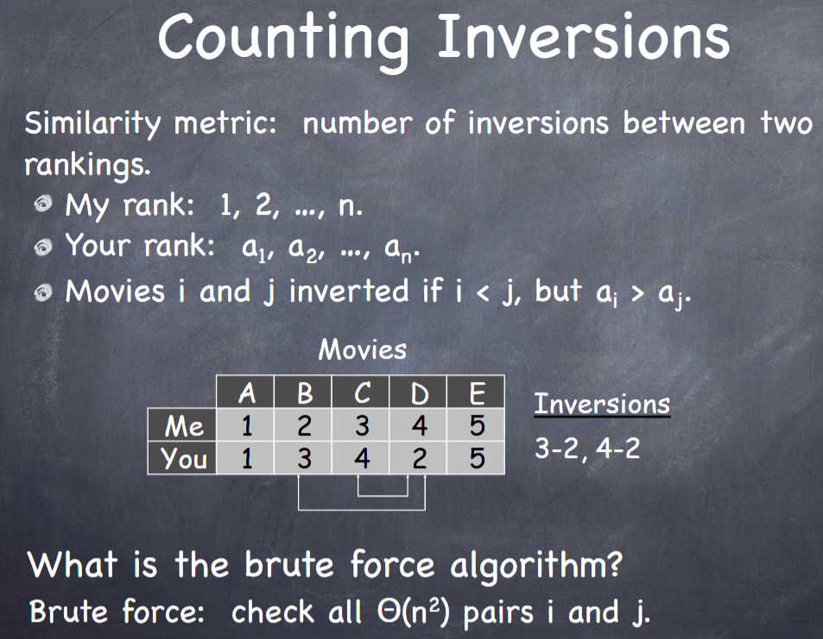

Slide 4
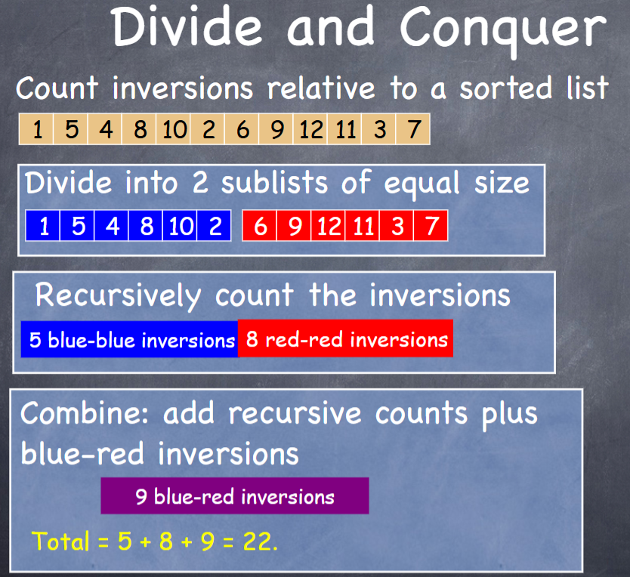

Slide 5
Merging & Counting Inversions
MergeAndCount(A, p, q, r)
1 n₁ ← q – p + 1
2 n₂ ← r – q
for i ← 1 to n₁
do L[i] ← A[p + i – 1]
for j ← 1 to n₂
do R[j] ← A[q + j]
L[n₁+1] ← ∞
R[n₂+1] ← ∞
i ← 1
j ← 1
cnt ← 0
for k ←p to r
do if L[i] ≤ R[j]
then A[k] ← L[i]
i ← i + 1
else A[k] ← R[j]
j ← j + 1
cnt ← cnt + n₁-i+1
return cnt
Input: Array containing sorted subarrays A[p..q] and A[q+1..r].
Output: Merged sorted subarray in A[p..r].

Slide 6
Counting Inversions
Statement Cost
So T(n) = Θ(1) when n = 1, and 2T(n/2) + Θ(n) when n > 1
CountInversions(A, p, r)
if p < r
then q ← ⎣(p+r)/2⎦
x ← CountInversions (A, p, q)
y ← CountInversions(A, q+1, r)
z ← MergeAndCount(A, p, q, r)
return x+y+z

